Slide 1
LATIN AMERICA AND CARIBBEAN REPORT
CBF COORDINATORS MEETING
ROME Nov 2016

Slide 2
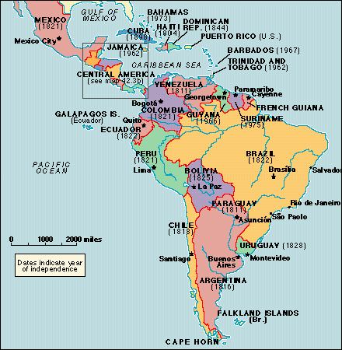

Slide 3
OVERVIEW
Latin America & the Caribbean
accounts for 8.6% (638 million)
of the world´s population of 7.14 billion. It is:
  increasingly urban (80%)
  Most unequal part of the world.
    The richest 20% control 57% of all resources while the poorest 20% a mere 3.5% of resources.
  “The great masses of poor who are unable to emerge from their state of prostration”
  (Report from Southern Cone Zone Coordinator)

Slide 4
OVERVIEW
Formal democratic structures while:
    “Corruption,
    Impunity,
    delinquency,
    high rates of maternity in under 15’s,
    irresponsible fatherhood,
    violence and other evils”
continue to plague the region
(cf. Report from Andean Countries Zone Coordinator)

Slide 5
OVERVIEW
2 countries with the most Catholics in the world:
Brazil 125 million, Mexico 99 million
Brazil. Highest income inequality in OECD, Only .8% of national income to poorest 10%
Mexico. Second most unequal country among major developed and developing countries.

Slide 6
OVERVIEW
Catholics:
500 million, or 40% of the world’s 1.1 billion Catholics.
In 1910, 2/3 of Catholics lived in Europe and 24% in Latin America and the Caribbean (LAC).
By 2010 a radically reversal:
LAC represents 40% and rising, of all Catholics, in contrast to the falling 24% of Catholics in Europe.
The “southern” face of the Catholic Church
Catholic % of population is unevenly distributed:
  - 85% in Mexico
  - 41% in Uruguay,
  - down to 2% in Jamaica.

Slide 7
OVERVIEW CBF, FEBIC lac
112 Episcopal Conferences worldwide
-101 are full members of CBF
  - 22 all conferences of LAC CBF members
  - 238 associate members worldwide 93 in LAC
115 of all 340 CBF members in FEBIC LAC = 33%
Four Zones:
- Southern Cone: Argentina, Brazil, Chile, Paraguay & Uruguay. 39 CBF members Coordinator Gerardo Garcia
- Andean: Bolivia, Colombia, Ecuador, Peru & Venezuela
28 CBF members. Coordinator Rebeca Cabrera
- Central America and Mexico: Guatemala, Honduras, El Salvador, Nicaragua & Panama y Mexico. 17 members Coordinator Antonino Cepeda
- Caribbean: Spanish, English, French and Dutch speaking countries. 26 members Coordinator Maria Diaz-James

Slide 8
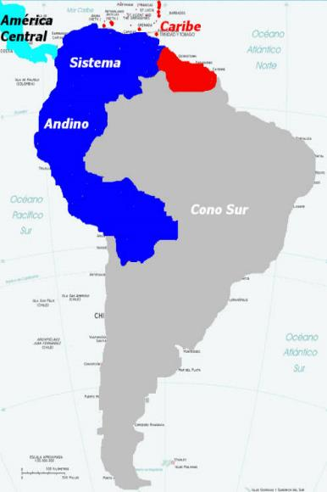
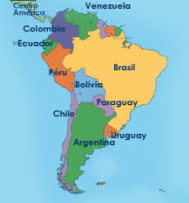
OVERVIEW CBF-FEBIC LAC ZONES

Slide 9
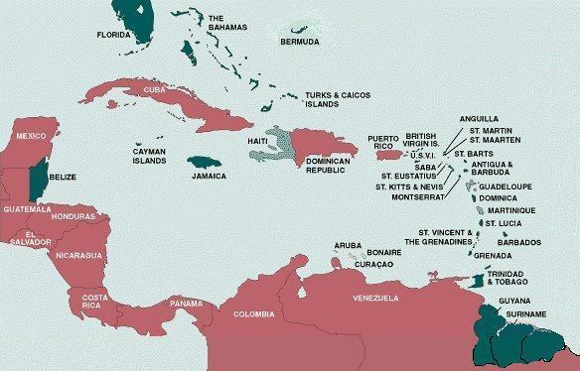

Slide 10
Aparecida celam 2007
We encounter Jesus in Sacred Scripture read in the church.
SS “Word of God written by inspiration of the Holy Spirit,” is, along with tradition, source of life for the Church and soul of its evangelizing action.
To be ignorant of scripture is to be ignorant of Jesus Christ and to fail to proclaim him.
Hence Benedict XVI’s invitation:
“At the beginning of this new phase that the missionary Church of Latin America and the Caribbean is preparing to enter, starting with this Fifth General Conference in Aparecida, an indispensable pre-condition is profound knowledge of the word of God”

Slide 11
Aparecida celam 2007
To achieve this, we must train people to read and meditate on the word of God: this must become their staple diet, so that, through their own experience, the faithful will see that the words of Jesus are spirit and life (cf. Jn 6:63).
Otherwise, how could they proclaim a message whose content and spirit they do not know thoroughly?
We must build our missionary commitment and the whole of our lives on the rock of the word of God. (Benedict XVI Opening Address)
Aparecida Document AD 247

Slide 12

Aparecida celam 2007
Hence, the importance of a “biblical ministry” understood as biblical animation of all pastoral life ,
that it serve as school of:
- interpretation or knowledge of the Word,
-communion with Jesus, or prayer with the Word,
-evangelization or proclamation of the Word.
This demands that bishops, priests, deacons, and lay ministers of the Word approach sacred scripture in a way that is not merely intellectual and instrumental, but with a heart “hungry to hear the Word of the Lord” (Am 8:11).
AD 248

Slide 13
Verbum Domini (2010)
Biblical Animation of all Pastoral Life (ABP)
Verbum Domini called for a greater “biblical apostolate”, not alongside other forms of pastoral work, but as a means of letting the Bible inspire all pastoral life”».
This does not mean adding a meeting
here or there in parishes or dioceses,
but rather of examining the ordinary activities of Christian communities, in parishes, associations and movements,
to see if they are truly concerned with fostering a personal encounter with Christ, who gives himself to us in his word.”
(VD 73).

Slide 14

Family
Social Pastoral
Seminaries
Childhood
Missions
Education
Youth
Priesthood
Pastoral
Vocations
Liturgy
Religious
Permanent Diaconate
ABP
ABP
Catechist
A
B
P

Slide 15
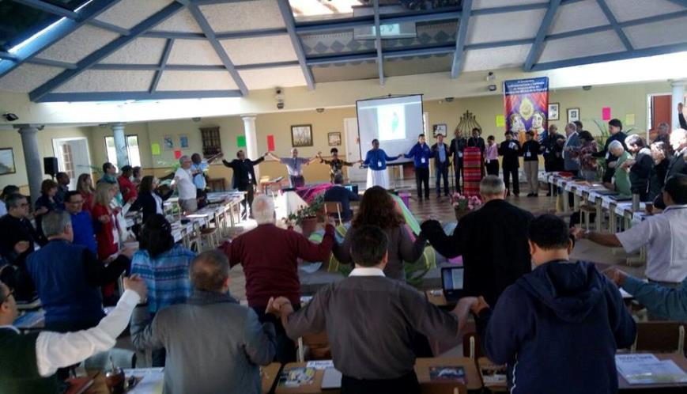
II ABP Encounter 12-14 Aug,2016 Quito
.

Slide 16
The major achievement since Nemi: the priority of ABP for the entire continent
The Word of God enlightens every human being so as to understand the Mystery of Salvation and Redemption:
Jesus Christ, in his words and deeds reveals God as a merciful Father who leads us from death to life and makes us sons and daughters, brothers and sisters.
Biblical animators are a witnesses to this mission and prophets who participate in the history of their people, seeking to orient and transform them according to the Word of God. (Message II ABP Encounter Quito, Ecuador August 2016)

Slide 17
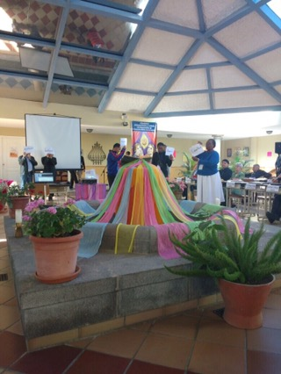
Enthroning the bible - Quito

Slide 18
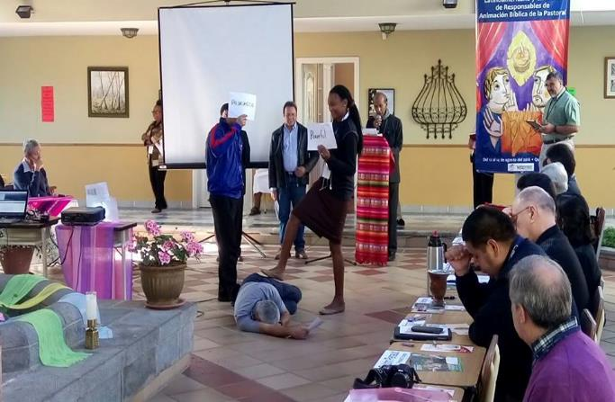
Lectio divina - The Good Samaritan
.

Slide 19
ABP Orientations for LAC
"Guidelines for Biblical Animation of all Pastoral Life in Latin America & the Caribbean"
The seven chapters of the document follow the Emmaus narrative:
  the Journey, the Pilgrim, Scriptures, the Lodging, the Bread, the Heart and the Community,
which are reflected in the ABP process and to which were are all invited to share in our pastoral ministry.

Slide 20
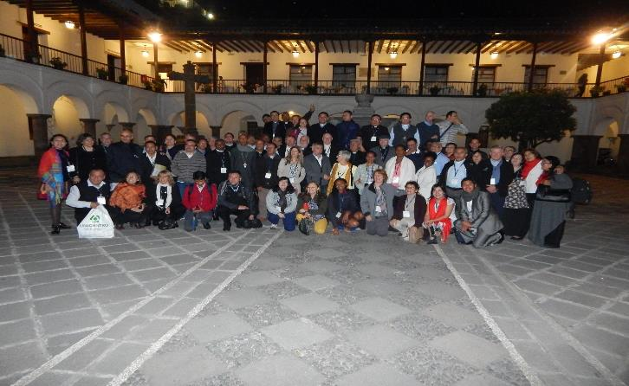
84 Participants
26 priests; 18 lay women; 15 archbishops and bishops; 11 religious sisters, 9 laymen; 4 permanent deacons; & 1 religious brother

Slide 21
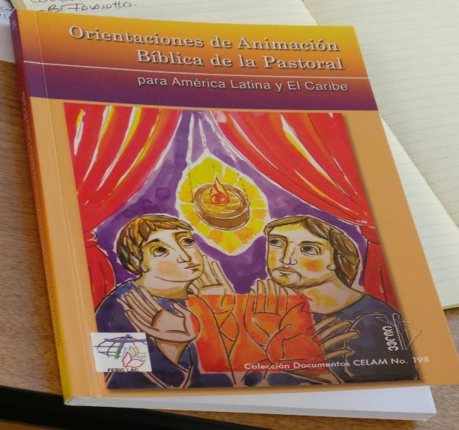
ABP guidelines for Latin America and the Caribbean
.

Slide 22
Message II ABP Encounter Quito
Thus motivated by this great revelation,
and conscious that we are the salt and light of the world,
we continue the work that others have already started since the Second Vatican Council,
though the leadership of Latin American and Caribbean Church and in previous meetings of the Catholic Biblical Federation (CBF/FEBIC) and Latin American Episcopal Council (CELAM).

Slide 23
Message II ABP Encounter Quito
We note the spirit of communion that enlivened our sharing
and which embodied the emergence of a synodal church,
reflected in more participatory structures
where laity, religious and ordained ministers men and women,
from different countries and cultures work alongside each other.

Slide 24
Message II ABP Encounter Quito
Communion with the Word will help us to create shared thoughts and joint actions,
where Sacred Scripture is the source from which will flow concrete projects
and benefit our peoples in cultural, political and economic fields.
.

Slide 25
Message II ABP Encounter Quito
“We want this message to help spread that same missionary zeal
of all those committed ABP evangelizers
who carry out their service to the Word of God
with joy, courage, and passion”

Slide 26
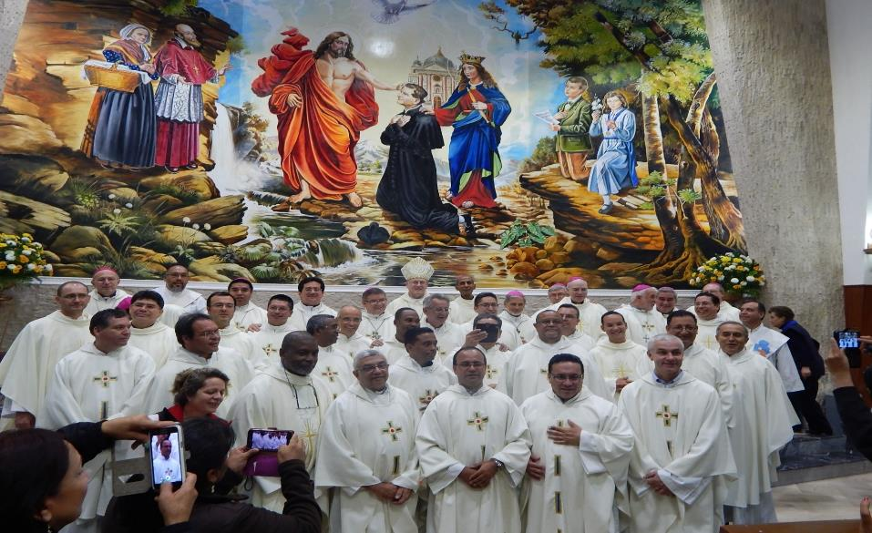
Eucharist at don Bosco Quito
“We want this message to help spread that same missionary zeal of all those committed ABP evangelizers who carry out their service to the Word of God with joy, courage, and passion.
.

Slide 27


.
II Latin American and Caribbean Biblical Animation of All Pastoral Life (ABP) Encounter
Quito (Ecuador) 12-14 August 2016
ROADMAP 2016 - 2019
FEBIC- LAC (Catholic Biblical Federation - Latin America and the Caribbean) and
the Biblical School of CEBITEPAL (Biblical, Theological and Pastoral Centre for Latin America and the Caribbean)
together with representatives of the Episcopal Conferences and Associate Members of FEBIC-LAC
endorse and commit ourselves to implementing the following roadmap, within the period 2016 and the end of 2019.

Slide 28
ABP ROADMAP 2016-2019
Approved unanimously Quito Encounter August 2016
Based on inputs received from members of the Catholic Biblical Federation, summarized, presented, discussed
Covers 4 main areas of bible ministry: training, communication, coordination and material aids needed to implement ABP effectively.

Slide 29
ABP ROADMAP 2016-2019
COMMUNICATIONS
Continue the process of spreading ABP in Latin America and the Caribbean in implementing Aparecida No. 248 and Verbum Domini No. 73 taking into consideration the following aspects:
a) Publicising the Guidelines for Biblical Animation of all Pastoral Life in LAC including translations
b) Developing a simple common brochure that explains what is ABP as well as its three dimensions: interpretation, communion and evangelization with the Word
c) Website to promote the participation of all and to publicise significant ABP experiences, programmes and related events.

Slide 30
ABP ROADMAP 2016-2019
COMMUNICATIONS (continued)
d) Maintaining a preferential option for young people (e.g. by promoting the Lectionautas project) and for the poor.
2. Develop a directory of lecturers, teachers, preachers to serve as resource persons for encounters, retreats and seminars in ecclesial communities.
3. Promote the setting aside of a special time dedicated to the Bible during the year (day, week, month) with ABP focussed material aids..

Slide 31
ABP ROADMAP 2016-2019
MATERIAL AIDS
1. Develop and share material aids (booklets or brochures) based on the Guidelines for the Biblical Animation of
  all Pastoral Life in Latin America and the Caribbean, adapted to the various areas and pastoral realities.
2. Publicise the Statutes of FEBIC-LAC among Bishops, Episcopal Conferences and associate members
3. Develop a CBF/FEBIC informative brochure.

Slide 32
ABP ROADMAP 2016-2019
TRAINING
1. Promote training taking into consideration interdisciplinary dialogue with other ecclesial and socio-cultural environments.
2. Continue to support the conduct of workshops, study courses, seminars and other training courses based on ABP, with a priority on grass root groups and leadership training.
3. Implement training processes for missionary disciples inspired by the variety of biblical models and the proposal of Aparecida (AD No. 240 et seq).
4. Promote training programmes for seminaries and houses of religious formation.

Slide 33
ABP ROADMAP 2016-2019
TRAINING (continued)
5. Strengthen and revitalize training opportunities for ABP agents with prophetic focus, in dialogue with the various socio-political and cultural realities, based on the Guidelines
6. Continue spreading the practice of Prayerful Reading (Lectio Divina) at all levels of the Church, so that it becomes the lifestyle of missionary disciples.
7. Implement the DEI VERBUM course offered by the CBF.

Slide 34
ABP ROADMAP 2016-2019
COORDINATION
1. Promote, from a prophetic perspective, social transformation in the midst of this era of change.
2. Support pastoral conversion processes in local church communities, leading to the implementation of integrated pastoral plans from the perspective of communion and synodality (walking together).
3. Encourage the use of the Internet to maintain regular contact and meetings between all institutions involved in ABP.

Slide 35
ABP ROADMAP 2016-2019
COORDINATION (continued)
4. Continue to promote the creation and consolidation of ABP teams at all levels.
5. Promote the holding a Bible Year from 2019 -2020 on the occasion of the 50th anniversary of the founding of the CBF and the commemoration of the 1600 anniversary of the death of St. Jerome.
6. Encourage links with Bible Societies.

Slide 36
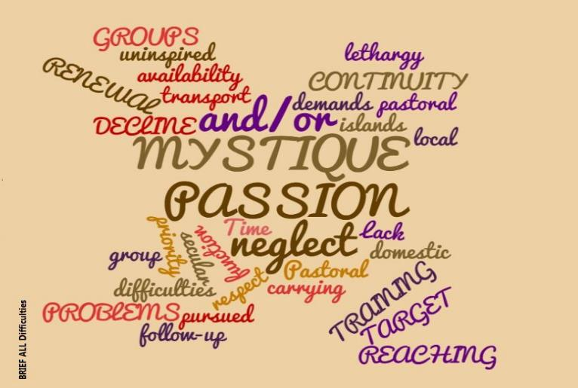
MYSTIQUE PASSION FOR THE Word of God

Slide 37
  Other Major achievements since Nemi
Passion for the Word of God, the desire to evangelise and the inspiration of the Holy Spirit has been our driving force- Savouring reading and proclaiming the Word;
Increasing close collaboration, mutual support and joint activities between full members (Episcopal Conferences/CELAM) and associate members (Bible institutes, lay ABP groups, dioceses, religious congregations
Reactivation of FEBIC LAC in several areas of the Region
Numerous online courses Lectio Divina, ABP e.g.. Bolivia, Argentina, Chile
Very active sharing of ABP and Biblical Pastoral Activities on FEBIC BLOG https://blog.febic.org/

Slide 38
Other Major achievements since Nemi
Lectio Divina in its different forms an increasing common form of prayer across the region along with enthronization of Bible in churches and homes
More regular Bible weeks, all across the region
Adoption by AEC bishops and individual diocesan Synods of the Word of God and ABP as priorities for the entire church
Catholic publishing houses in Southern Cone, Andean countries place high priority on the Word of God for popular study, reflection, prayer

Slide 39
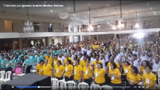
Paraguay, Ciudad del Este:
III DIOCESAN Encounter OF 1,200 BIBLE STUDENTS 2 OCT. 2016
.

Slide 40
A few PROPOSED activities at regional, zone levels 2017
Encounter Bible Scholars. Uruapan Mexico 23-26 January
Translation and Promotion of ABP Guidelines To The Other Major Languages of LAC (Portuguese & English) (April 2017)
CEBITEPAL CELAM ABP Encounters. Andean Zone, Lima Peru 25-26 March Central America & Mexico Zone. Costa Rica 10-11 June
CELAM Refresher Bible and ABP Course for Caribbean Bishops 19-23 June
Annual Meeting of Regional Executive Committee (CER) 12 July Argentina
Workshop on ABP Project Design, Implementation, Donor Agency Cooperation at time of CER Annual Meeting
IX National ABP Encounter, Argentina (14-16 July 2017)
Encounter of Coordinators of Youth Bible Programmes, Brazil, July 2017
CEBITEPAL/CELAM Sponsored ABP Workshop/Encounter In English Trinidad, 2-13 October 2017
Seminar FEBIC-LAC Andean Zone 2017

Slide 41

MAIN CHALLENGES
Persistent fundamentalist and doctrinaire approaches to evangelization and the Word of God (Catholic and Non Catholic) All regions esp. Andean, Caribbean reports
A major stumbling block is “pastors who perceive ABP as something that undermines their pastoral role” ¨Turfism
Unwillingness to re-integrate some already existing bible initiatives/movement/plans into diocesan ABP initiatives
The biggest challenge is to make things happen, to arouse the desire to study the Bible.

Slide 42
Family
Social Pastoral
Seminaries
Childhood
Missions
Education
Youth
Priesthood
Pastoral
Vocations
Liturgy
Religious
Permanent Diaconate
Catechist
ABP
ABP
A
B
P

Slide 43
.
THE SEED IS THE WORD OF GOD
Lk 8:11
GO, THEREFORE,
MAKE DISCIPLES OF ALL NATIONS
Mt:28:19

